Slide 1

Does investing in education reduce STI risk in California?
Isaac
Chammah
isaacchammah@gmail.com

Slide 2
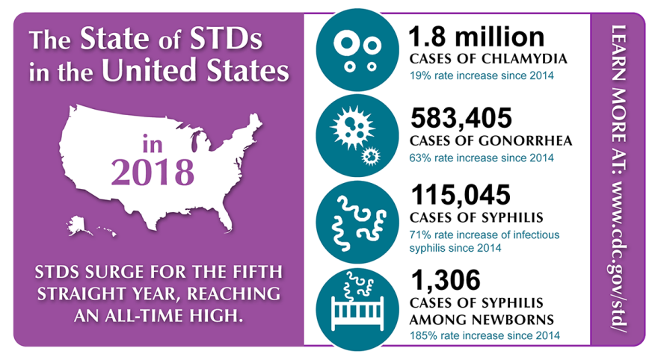
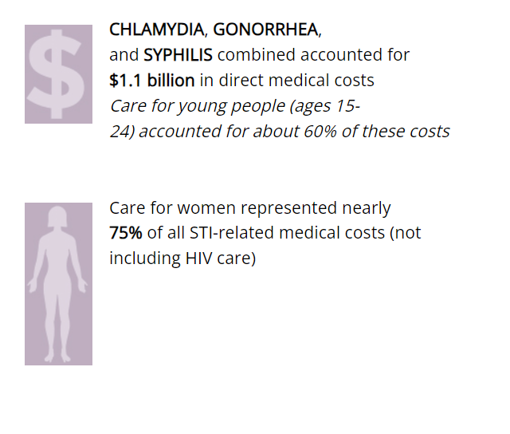
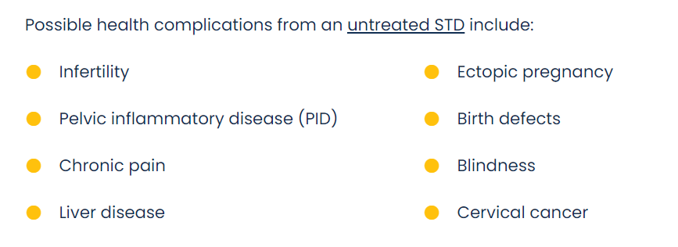
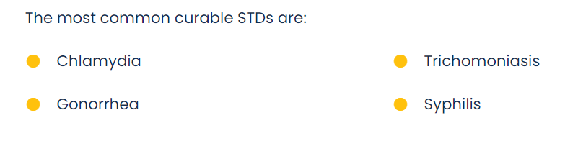
Motivation

Slide 3
Data
Integrated data from three distinct data frames:
1. Incidence of Gonorrhea, Syphilis, and Chlamydia cases among males and females in California counties (excluding San Francisco) spanning 2001 to 2020.
2. Comprehensive county expenditure information across various sectors, encompassing education, spanning 2003 to 2020.
3. County Federal Information Processing Standards (FIPS) codes.
https://data.chhs.ca.gov/

Slide 4
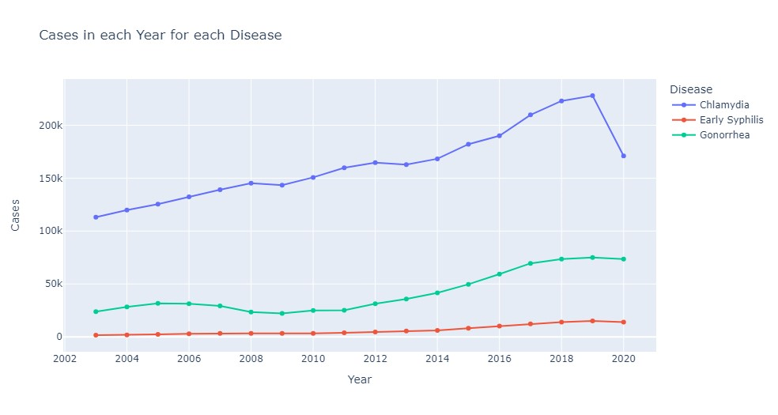
Insights
Chlamydia consistently tops the charts as the most prevalent and highly infectious disease over the years.

Slide 5
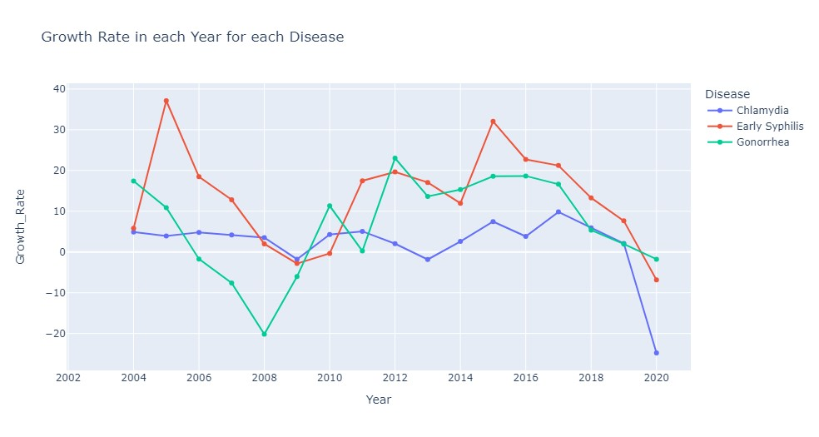
Insights
Approximately only 20% of the time over the span of 18 years, there was a decrease in STI infections.

Slide 6
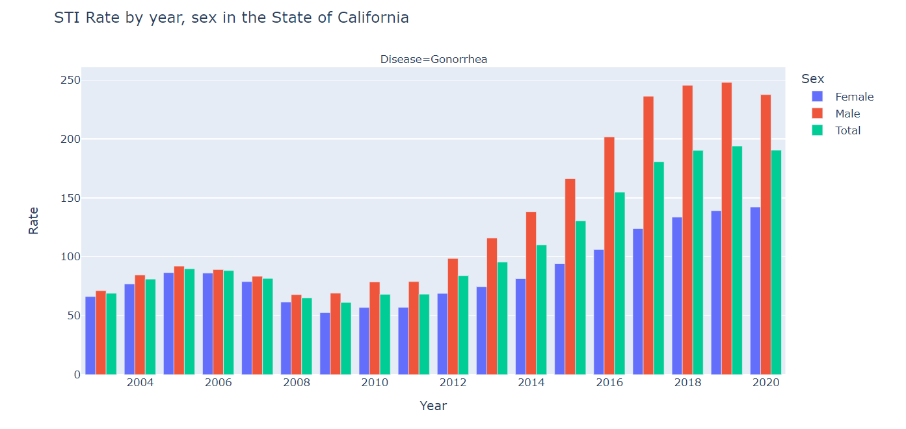

Slide 7
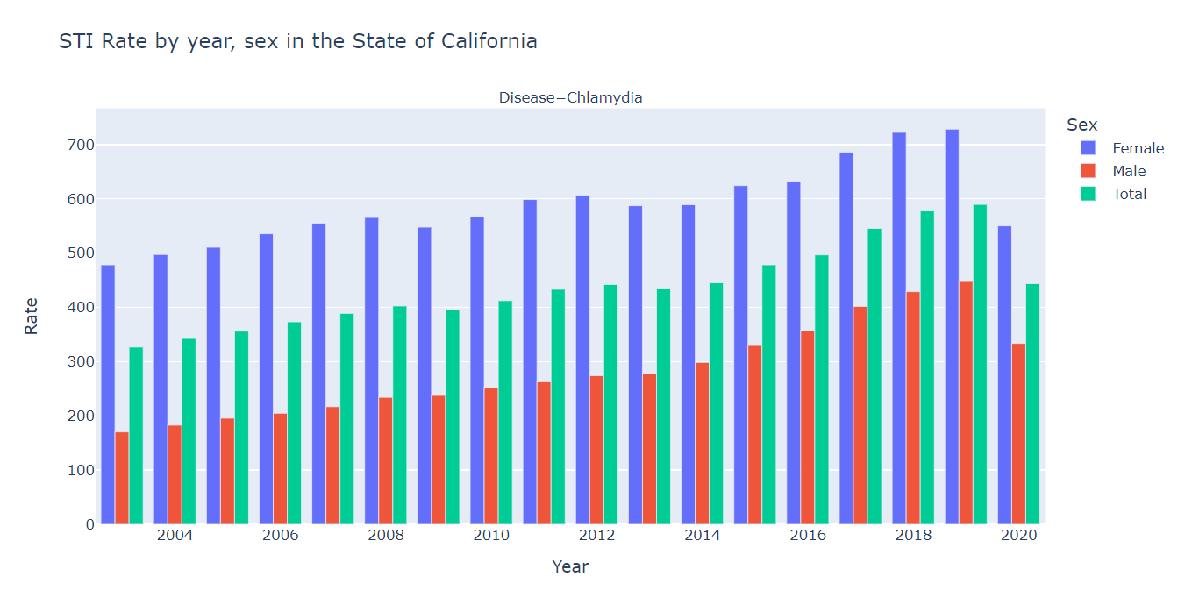
Insights
Women are at a greater risk group for STI infections..
Insights
Chlamydia itself won't kill you, but if it damages a woman's fallopian tubes, leading to an ectopic pregnancy, the fallopian tube can rupture, causing internal bleeding and death if not treated promptly.

Slide 8
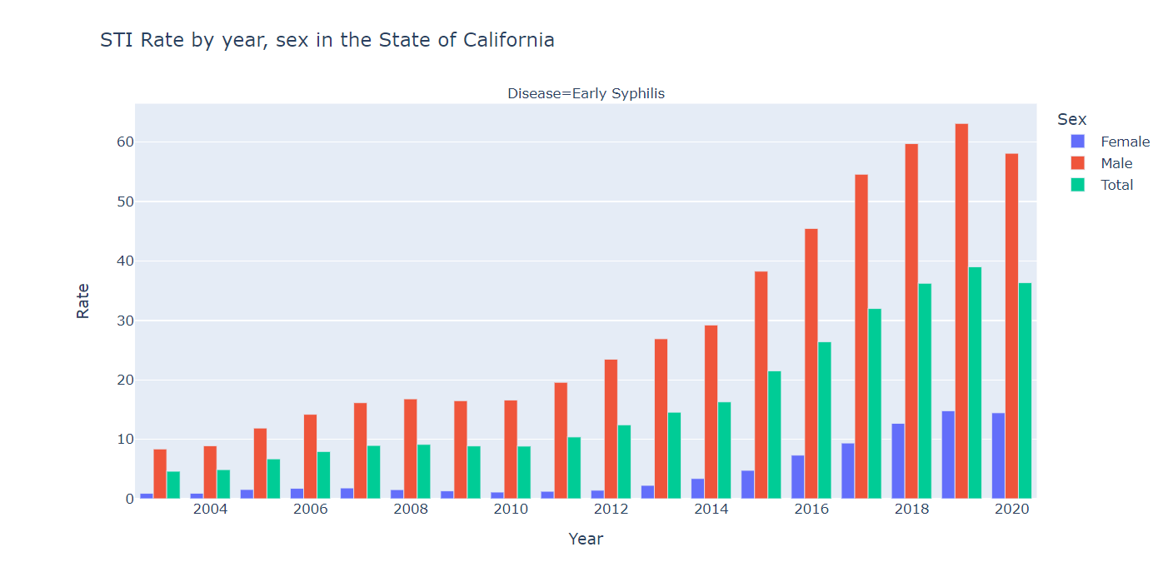

Slide 9
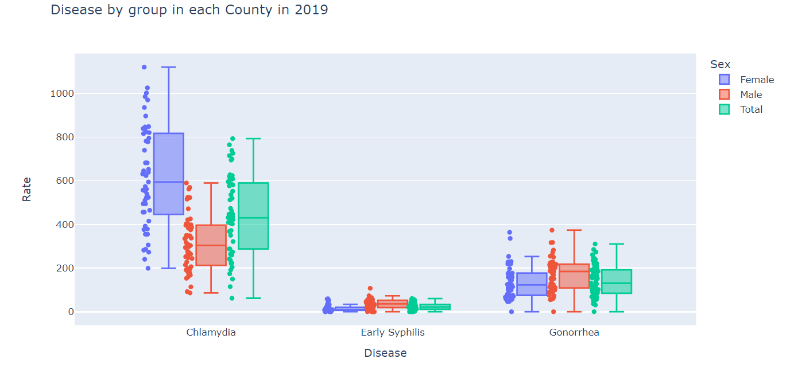

Slide 10
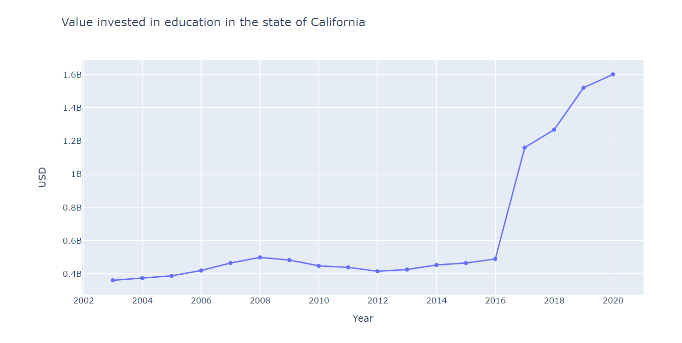

Slide 11
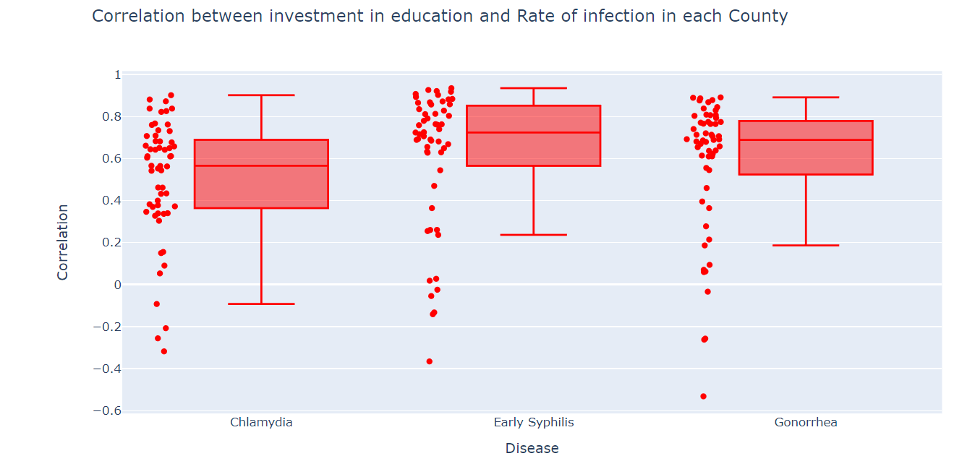
Insights
Despite increased investment in education over the years, STI spread in California remained uncontrollable.

Slide 12

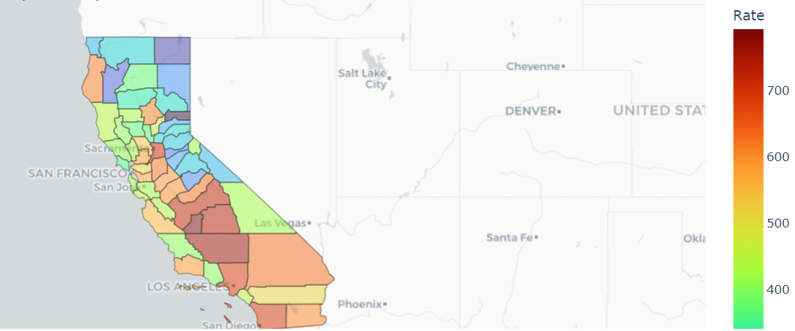
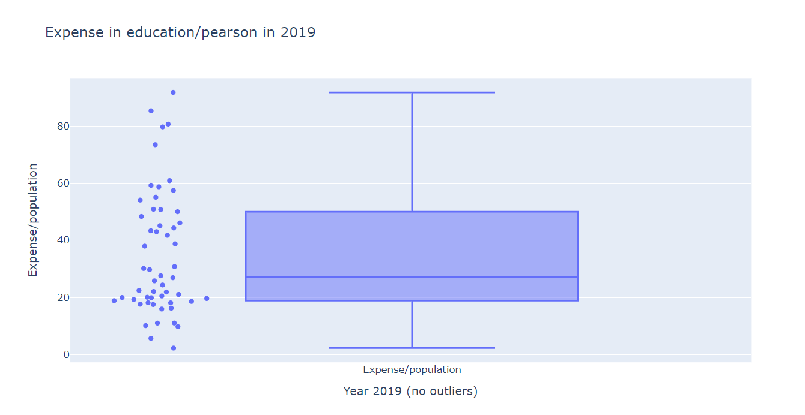

Gonorrhea
Chlamydia
Insights
Los Angeles, a state with a soaring infection rate despite significant investments in education.
Syphilis

Slide 13
Future work
Study why some counties have such a large rate compared to others
What specific tipe of investment in education can help to prevent STI
Extensive research on what specifically influences a person to be safe trought sexual activities
Invest in t
https://data.chhs.ca.gov/

